Slide 1
Multi-criteria optimization of budget allocation for resilience improvement of critical infrastructures exposed to natural hazards and climate change

Slide 2
2
Current features
Hazard modelling: flood events depth and duration sampled with copula and then spatially mapped onto the system topology (deterministic).
Climate change modeling: the optimization allows selecting one specific climate scenarios or to sample one scenario in each realization (for robust agent training).
Impact computation: the environment uses the sampled water depths to calculate the assets fragility, estimates downtime via recovery-time distributions (plus flood duration), and aggregates lost gas/power supply and affected population.
Observations (system state): current wall height for each asset and current sea level. Partial observation of preferences?
Actions: seven wall-height increments (0 to 3 m in 0.5 m steps) per asset. Repeated upgrades of same asset on consecutive decision times (every 5 years from 2025 to 2100) are cancelled and penalized.
Budget enforcement: proposed upgrades are costed with a wall cost model (STILL NEED REALISTIC AREAS FOR EACH ASSET). If the yearly spend exceeds the budget, the most expensive increments are deleted until feasible.
Reward shaping: losses for gas vs electricity and economic vs societal impacts are combined with the dynamic weight vector for decision-maker preferences.

Slide 3
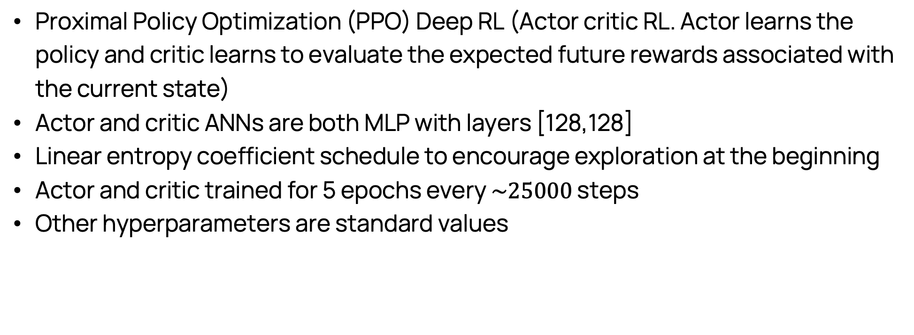
3
More technical stuff
Proximal Policy Optimization (PPO) Deep RL (Actor critic RL. Actor learns the policy and critic learns to evaluate the expected future rewards associated with the current state)
Actor and critic ANNs are both MLP with layers [128,128]
Linear entropy coefficient schedule to encourage exploration at the beginning
Actor and critic trained for 5 epochs every $\sim 25000$ steps
Other hyperparameters are standard values

Slide 4
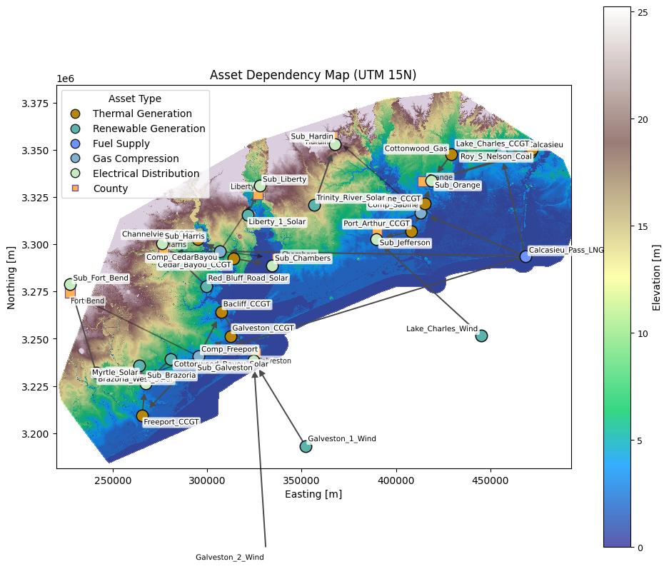
Network structure

Slide 5
Environment test

Slide 6
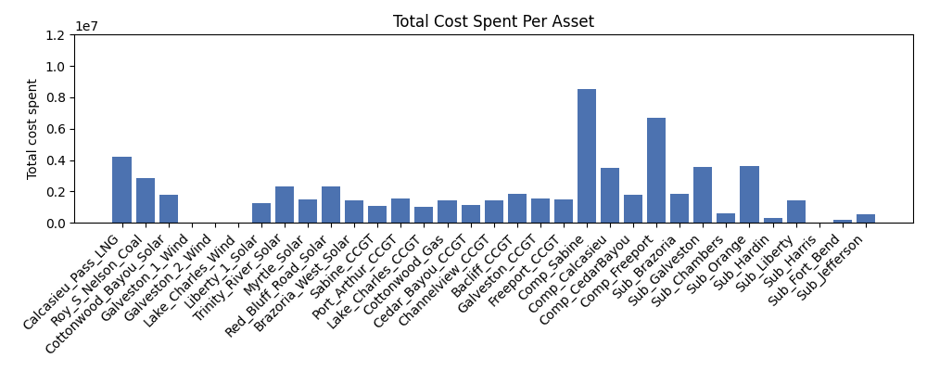
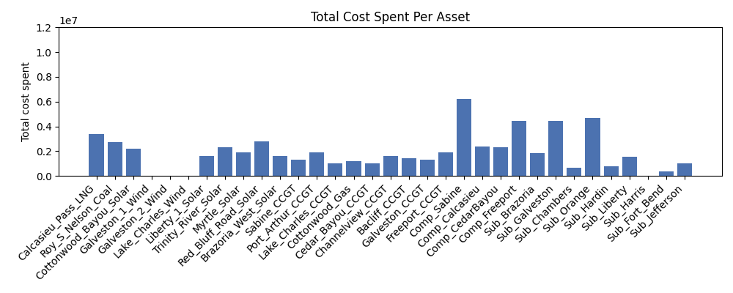
Optimization test
More investments on compressors
More investments on LNG
Gas-economic
No investments on wind in both ☺
More investments on substations
Electricity-social

Slide 7
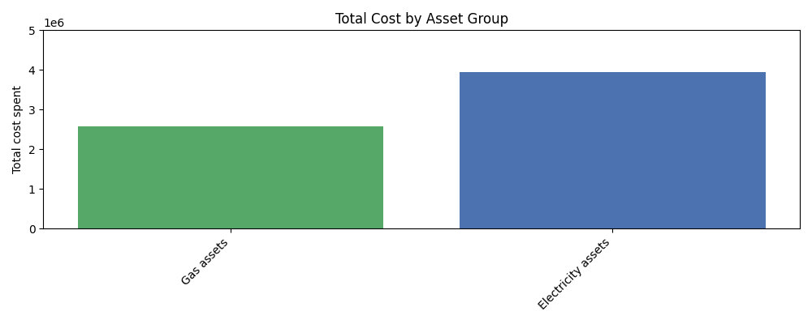
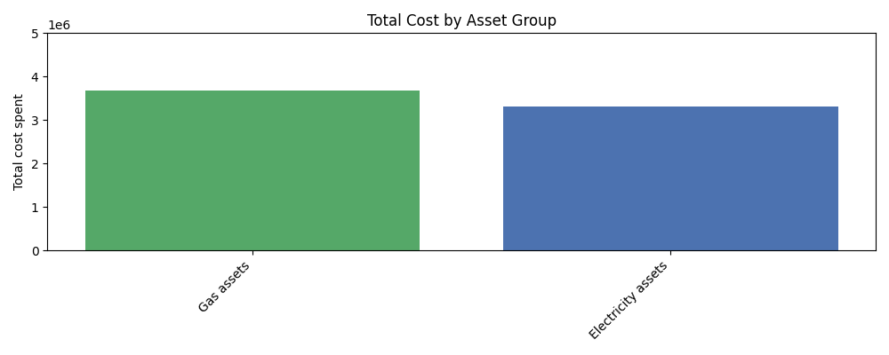
Optimization test
Electricity-economic
Gas-economic

Slide 8
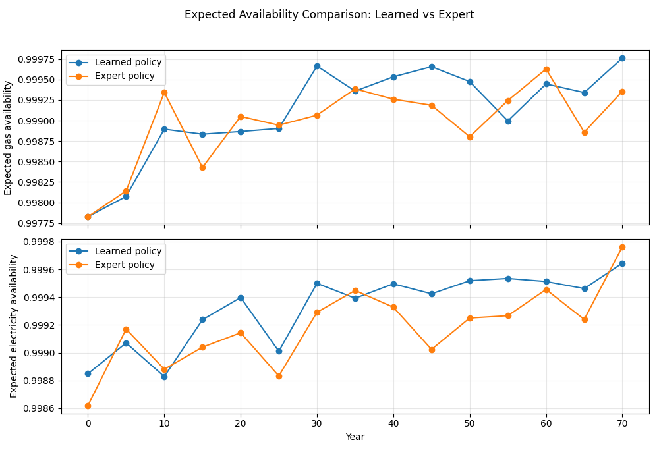
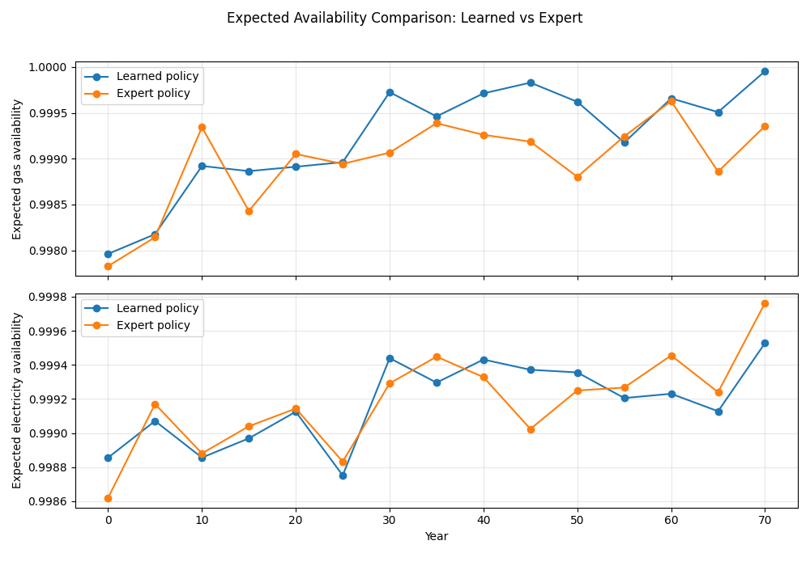
Optimization test vs expert-based policy
Electricity-economic
Gas-economic

Slide 9
TODO list
Wall cost model (Thomas)
Areas of each asset that can be improved (Santi)
What to add to observations (system state) other than wall height and sea level (Santi)
Our expert-based policy (improve the most fragile and exposed asset every time step)
Ste:
Try to do gas-economic and electricity-economic
Shift the background in the plotting to match the elevation map
Put the county as nodes and connect substations and compressor to their county
Plot in time of the expected losses without actions and with actions
Plot in time of the reward of the trained policy and the expert-based policy

Slide 10
Possible extensions for journal
In conference paper only nodes fail (links are always safe) -> probably we have a hurricane to have such big floods -> wind fragility for electrical links (multi-hazard!) -> investments to improve the links
Allow investments to build new assets –> dynamic network
Multiple decision-makers and climate scenarios -> ”robust” agent

